Slide 1
C# and .NET Framework
Revision

Slide 2
Chapter 1 .NET Framework Introduction

Slide 3
.NET Solutions
Full interoperability with existing code
Complete and total language integration
A common runtime engine shared by all .NET-aware languages.
A base class library
No more COM plumbing
A truly simplified deployment model (no need to register a binary unit into the system registry)

Slide 4
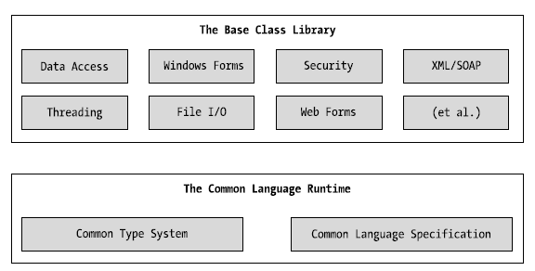
Blocks of the .NET Platform

Slide 5
Overview of .NET Assemblies
.NET Assembly's Format:
Win32 File Header
CLR File Header
CIL code
type metadata
assembly manifest
optional embedded resource

Slide 6
Common Intermediate Language (CIL)
Also known as Microsoft Intermediate Language (MSIL)
CIL is a language that sits above any particular platform- specific instruction set
the same idea as Java's virtual machine
Compilers of all .NET-aware languages emit CIL instructions
binaries are platform-independent
When the CIL code is about to run, the Jitter (just-in-time compiler) compiles it into native (machine) code
Jitter will cache resulting machine code in memory

Slide 7
Common Type System (CTS)
CTS fully describes all possible data types and programming constructs (types) supported by the runtime and details how they are represented in the .NET metadata format
Types in .NET:
Classes (sealed classes, implementing interfaces, abstract Classes, internal or public classes)
structures
Interfaces (named collections of abstract member definitions)
Enumerations
Delegates (equivalent of type-safe function pointer)

Slide 8
Common Language Specification (CLS)
CLS defines a subset of common types and programming constructs that all .NET programming languages can agree on
CLS can be viewed as a subset of the full functionality defined by the CTS.
Also, CLS defines a set of rules/features a given .NET-aware compiler must support to produce code that can be hosted by the CLR
Ex: overloading: methods, and constructors are allowed to be overloaded; fields and events must not be overloaded

Slide 9
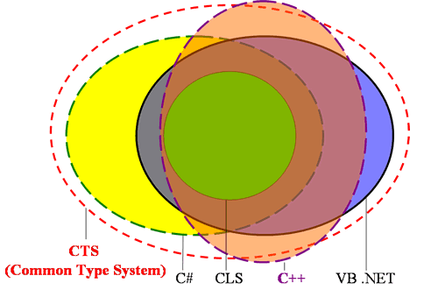
CTS vs CLS

Slide 10
Common Language Runtime (CLR)
CLR is physically represented by mscoree.dll library (Common Object Runtime Execution Engine)
this library is loaded automatically when an assembly is referenced for use
CLR responsibilities:
resolving the location of an assembly and finding the requested type within the binary by reading the contained metadata
loading the type into memory
compiling CIL into platform-specific instruction
performing security checks, executing the code

Slide 11
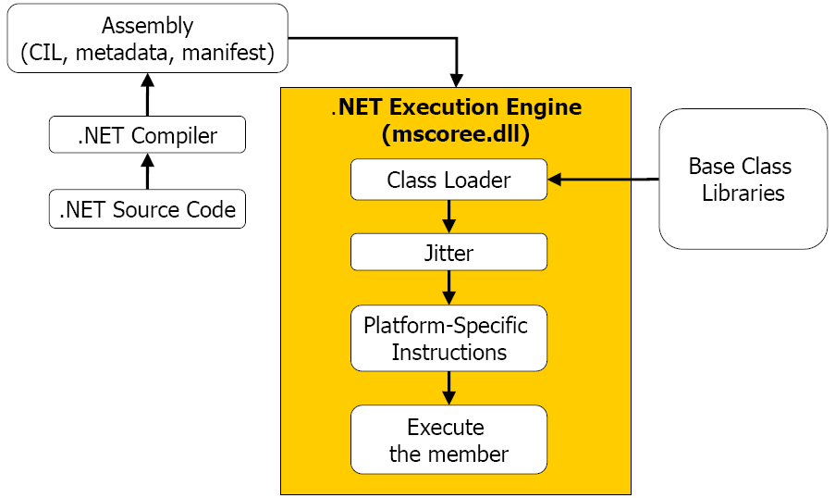
Common Language Runtime (CLR)

Slide 12
Chapter 3
C# Language Fundamentals

Slide 13
Member Visibility
C# access modifier | Description
public | Accessible from an object variable as well as any derived classes
private | Accessible only by the class that has defined the method. In C#, all members are private by default.
protected | Marks a method as usable by the defining class, as well as any derived classes. Protected methods, however, are not accessible from an object variable.
internal | The same assembly, but not outside the assembly.
protected internal | Access is limited to the current assembly or types derived from the defining class in the current assembly
Types (classes, interfaces, structures, enumerations, and delegates)
are limited to public or internal (default).

Slide 14
Defining Constant Data
C# offers the const keyword to define variables with a fixed, unalterable value.
It is important to understand that the value assigned to a constant variable must be known at compile time => constant member cannot be assigned to an object reference
All constant fields are implicitly static
Ex: public const string MyConstant = "Timberwolves";

Slide 15
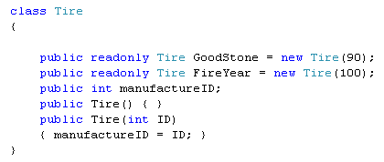
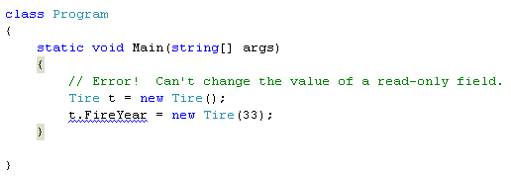
Defining Read-Only Fields
Read-only fields allow you to establish a point of data whose value is not known at compile time, but that should never change once established.
Read-only fields are not implicitly static
Cannot change the value of read-only field

Slide 16
Static Constructor
Prevent static field to be reset
A given class (or structure) may define only a single static constructor
A static constructor executes exactly one time, regardless of how many objects of the type are created
A static constructor does not take an access modifier and cannot take any parameters
The static constructor executes before any instance-level constructors

Slide 17
Method Parameter Modifiers
Parameter Modifier | Description
(none) | Parameters are passed by value
out | Output parameters are assigned by the method being called (and therefore passed by reference).
params | Allows having a number of identically typed arguments as a single logical parameter. A method can have only a single params modifier, and it must be the final parameter of the method.
ref | Parameters are passed by reference.

Slide 18
Value Types and Reference Types
Value-based types, which include all numerical data types (int, float, etc.), as well as enumerations and structures, are allocated on the stack
value types can be quickly removed from memory once they fall out of the defining scope
In contrast, reference types (classes) are allocated on the managed heap
these objects stay in memory until the .NET garbage collector destroys them

Slide 19


Boxing and Unboxing Operations
Boxing: converting a value type into a corresponding reference type by storing the variable in a System.Object.
Unboxing: converting the value held in the object reference back into a corresponding value type.

Slide 20
Chapter 4
OOP with C# 2.0

Slide 21
OOP - Encapsulation
Aggregation of data and behavior:
Data of a class should be hidden from the outside.
All data should be accessed only via methods.
A method should have a boundary condition (a limit on the range of arguments for which a method ca operate properly).
Ex: a square-root cannot operate on a negative number

Slide 22
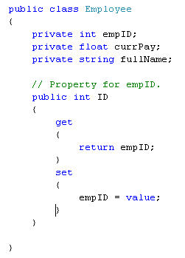
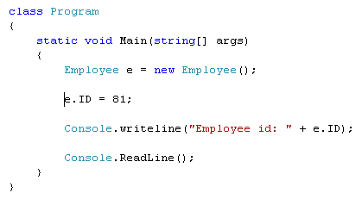
OOP - Encapsulation
Using Properties
the C# value token is not a keyword,
but rather a contextual keyword

Slide 23
OOP - Inheritance
Ability allows a class having members of an existed class ➔ Re-used code.
class PERSON
class STUDENT
ID_Num
Name
YearOfBirth
Address
getID_Num()
setID_Num(newID)
......
ID_Num
Name
YearOfBirth
Address
getID_Num()
setID_Num(newID)
......
inherited
“is a” relationship
extensions
RollNum
Score
getScore()
setSore(newScore)
......
class STUDENT
RollNum
Score
getScore()
setSore(newScore)
......
Son = Father + extensions

Slide 24
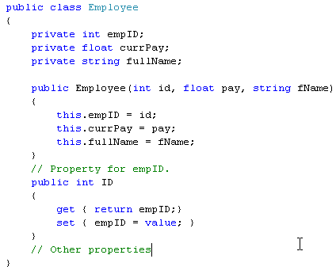
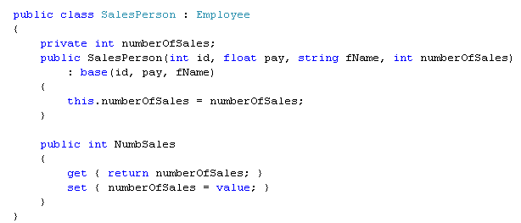
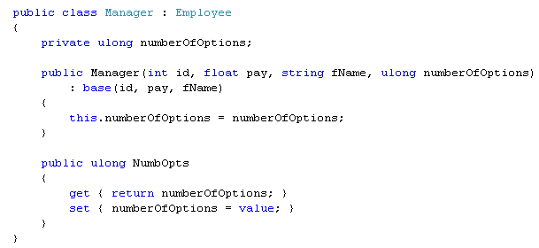
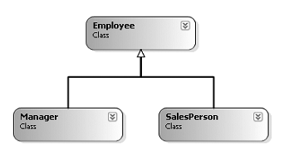
Inheritance Implementation in C#
Invoke parent’s constructor
Invoke parent’s constructor

Slide 25
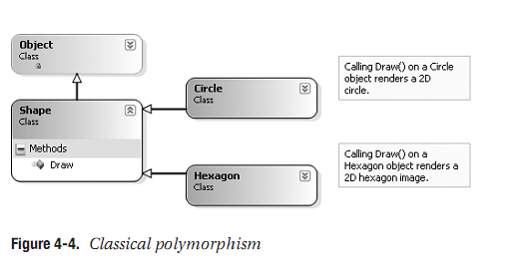
OOP - Polymorphism
Ability allows many versions of a method based on overloading and overriding methods techniques.

Slide 26
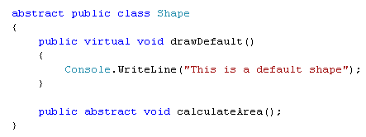
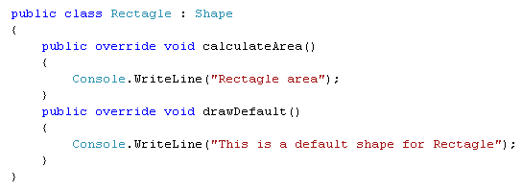
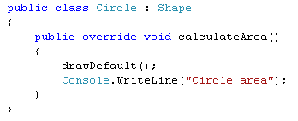
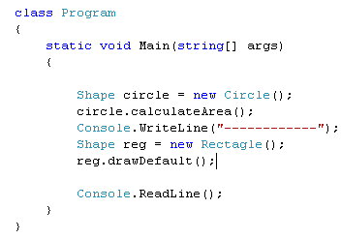
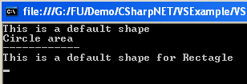
Polymorphism Implementation in C#
virtual : provide a default implementation. Can be overridden if necessary
abstract: sub-classes MUST override
Optional
Must
??
Besides virtual and abstract, C# provide new
keyword that applies to methods. What does
that mean?

Slide 27
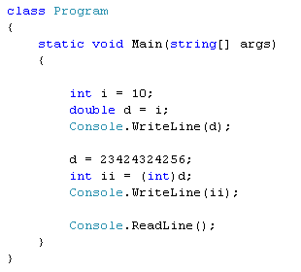

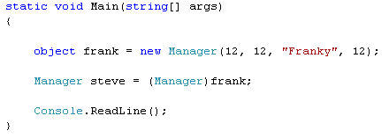
C# Casting Rules
Value type: conversion and casting
Convert smaller type to bigger type: OK (also called implicit cast)
Convert bigger type to smaller type: NOT OK => need an explicit cast => may cause loss of data
Lost data
Reference type: conversion and casting
Convert sub-class to supper class: OK (also called implicit cast)
Convert supper class to sub-class: NOT OK => need an explicit cast => may cause run time error

Slide 28
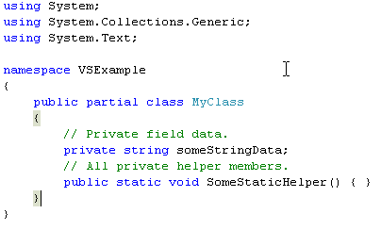
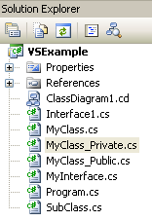
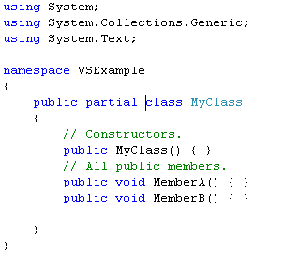
C# Partial Types
Same class name

Slide 29
Chapter 8
Delegates and Events

Slide 30
.NET Delegate Type
A delegate type maintains three important pieces of information:
The name of the method on which it makes calls
The arguments (if any) of this method
The return value (if any) of this method
// This delegate can point to any method,
// taking two integers and returning an integer.
public delegate int BinaryOp(int x, int y);

Slide 31
.NET Delegate Type
Invoke() is used to invoke each method maintained by the delegate type in a synchronous manner
meaning the caller must wait for the call to complete before continuing on its way
BeginInvoke() and EndInvoke() provide the ability to call the current method in an asynchronous manner (on a second thread of execution)

Slide 32
Understanding C# Events
Using event keyword, the registration and unregistration methods as well as any necessary member variable delegate types are done automatically.
Defining an event is a two-step process:
First, define a delegate that contains the methods to be called when the event is fired.
Next, declare the events (using the C# event keyword) in terms of the related delegate.
public class SenderOfEvents
{
public delegate retval AssociatedDelegate(args);
public event AssociatedDelegate NameOfEvent;
}

Slide 33
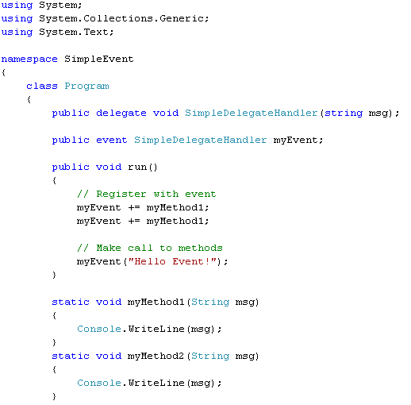
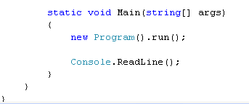

Simple event example
2

Slide 34
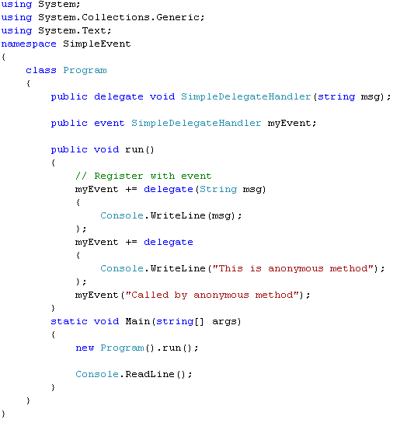

Anonymous Methods

Slide 35
Chapter 10
Understanding Generics

Slide 36
Problem with (Un)Boxing Operations
The performance issues
1. A new object must be allocated on the managed heap.
2. The value of the stack-based data must be transferred into that memory location.
3. When unboxed, the value stored on the heap-based object must be transferred back to the stack.
4. The now unused object on the heap will (eventually) be garbage collected.

Slide 37
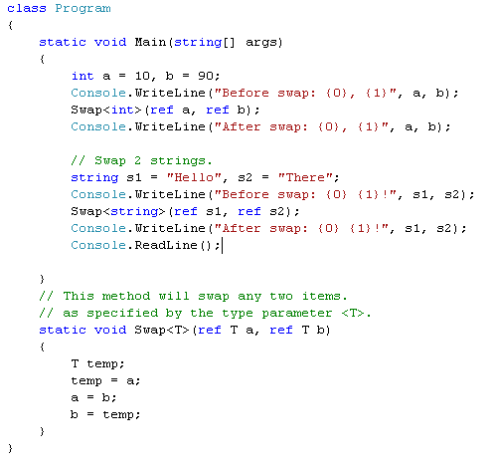
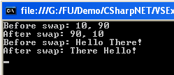
Generic Methods

Slide 38
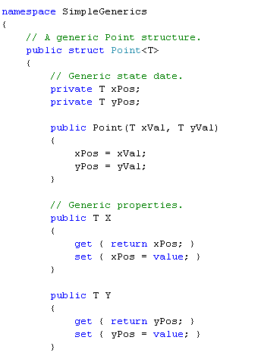
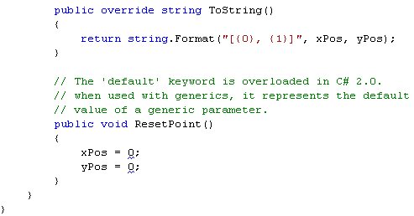
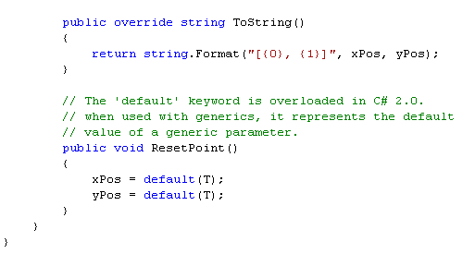
Default value in Generic
Error
OK
Ex: Ch_10 Code \SimpleGenerics

Slide 39
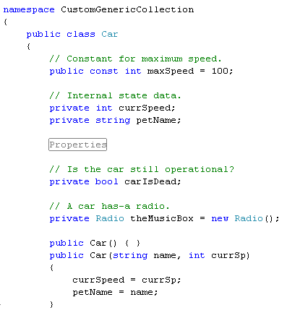
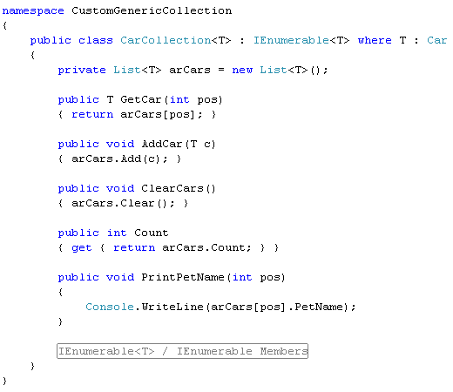
Constraints for Generic Type
OK
Full example: Ch_10 Code\CustomGenericCollection

Slide 40
Constraints for Generic Type
Generic Constraint | Description
where T : struct | The type parameter <T>must have System.ValueType in its chain of inheritance.
where T : class | <T>must be a reference type.
where T : new() | The type parameter <T>must have a default constructor and must be the last parameter.
where T : NameOfBaseClass | The type parameter <T>must be derived from the class specified by NameOfBaseClass.
where T : NameOfInterface | The type parameter <T>must implement the interface specified by NameOfInterface.

Slide 41
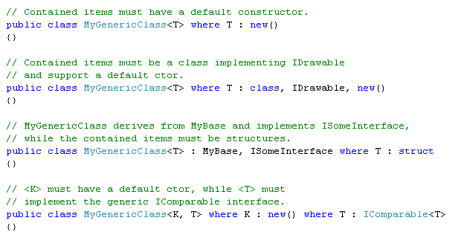
Constrain Example…
Must be the last

Slide 42
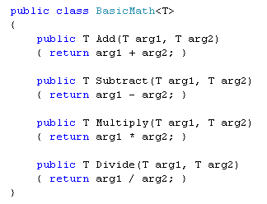
The Lack of Operator Constraints
Do not do this
A compiler error will apply any C# operators (+, -, *, ==, etc.) on the type parameters

Slide 43
Chapter 7
.NET Assemblies.

Slide 44
Role of .NET Assemblies
Assemblies Promote Code Reuse
a code library need not take a *.dll file extension.
a referenced *.exe can also be considered a “code library.”
a code library can be created in C# and reuse that library in any other .NET programming language. It is possible to not only allocate types across languages, but derive from them as well.

Slide 45
Role of .NET Assemblies
Assemblies Are Versionable Units
.NET assemblies are assigned a four-part numerical version number of the form <major>.<minor>.<build>.<revision>
This number, in conjunction with an optional public key value, allows multiple versions of the same assembly to coexist in harmony on a single machine.

Slide 46
Role of .NET Assemblies
Assemblies Are Self-Describing
Assemblies are regarded as self-describing in part because they record every external assembly it must have access to in order to function correctly.
A manifest is a metadata that describes the assembly itself (name, version, external assemblies, etc.).
In addition to manifest data, an assembly contains metadata that describes the composition (member names, implemented interfaces, base classes, constructors and so forth) of every contained type.

Slide 47
Role of .NET Assemblies
Assemblies Are Configurable
Assemblies can be deployed as “private” or “shared.”
Private assemblies reside in the same directory (or possibly a subdirectory) as the client application making use of them.
Shared assemblies, on the other hand, are libraries intended to be consumed by numerous applications on a single machine and are deployed to a specific directory termed the Global Assembly Cache (GAC).

Slide 48
Format of a .NET Assembly
A .NET assembly (*.dll or *.exe) consists of the following elements:
A Win32 file header
A CLR file header
CIL code
Type metadata
An assembly manifest
Optional embedded resources

Slide 49
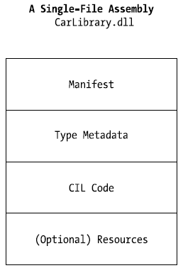
Format of a .NET Assembly
Single-File Assemblies
one-to-one correspondence between the (logical) assembly and the underlying (physical) binary

Slide 50
Format of a .NET Assembly
Multi-file Assemblies
A set of .NET *.dlls that are deployed and versioned as a single logic unit.
Primary module contains the assembly-level manifest (as well as any necessary CIL code, metadata, header information, and optional resources).
The modules are only logically related by information contained in the primary module’s manifest.

Slide 51
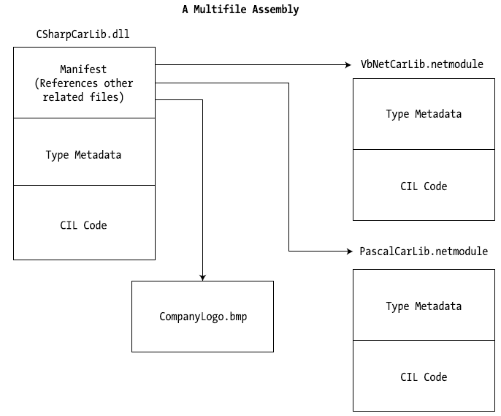
Format of a .NET Assembly
Multi-file Assembly

Slide 52
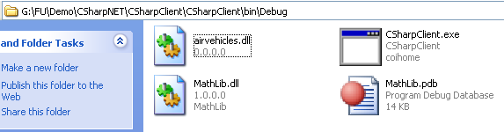
Private Assemblies
Private assemblies are required to be located within the same directory as the client application (termed the application directory) or a subdirectory thereof.
The Identity of a Private Assembly
The full identity of a private assembly consists of the friendly name and numerical version
The friendly name simply is the name of the module that contains the assembly’s manifest

Slide 53
Configuring Private Assemblies
The CLR will not probe the subdirectory to look for reference assembly unless you supply a configuration file
Configuration files must have the same name as the launching application and take a *.config file extension, and they must be deployed in the client’s application directory

Slide 54
Shared Assemblies
Like private assembly, a shared assembly is a collection of types and (optional) resources.
Difference between shared and private assemblies is the fact that a single copy of a shared assembly can be used by several applications on a single machine.
Shared assemblies are installed into the Global Assembly Cache (GAC) - C:\Windows\Assembly
Executable assemblies (*.exe) cannot be installed into the GAC.

Slide 55
Shared Assemblies
Understanding Strong Names
An assembly must be assigned a strong name before being deployed to GAC.
Strong name is used to uniquely identify “the publisher” of a given .NET binary.
Read more…

Slide 56
Shared Assemblies
A strong name is composed of a set of related data:
The friendly name of the assembly
The version number of the assembly (assigned using the [AssemblyVersion] attribute)
The public key value (assigned using the [AssemblyKeyFile] attribute)
An optional culture identity value for localization purposes (assigned using the [AssemblyCulture] attribute)
An embedded digital signature created using a hash of the assembly’s contents and the private key value

Slide 57
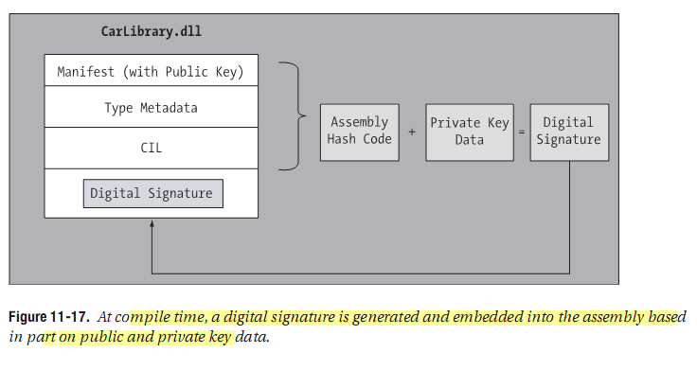
Shared Assemblies

Slide 58
Chapter 14:
Building Multithreaded Applications

Slide 59
Processes and Multi Processing System
A process has a self-contained execution environment. A process generally has a complete, private set of basic run-time resources; in particular, each process has its own memory space.
Multi Processing/ Multi Tasking System: System allows many processes executing concurrently.

Slide 60
How can OS manage concurrent processes
App | Code Addr | Duration (mili sec) | CPU
App1 | 10320 | 15 | 1
App2 | 40154 | 17 | 2
App3 | 80166 | 22 | 1
… | … | … | …
… | … | … | …
App1
Code
Data
App2
Code
Data
App3
Code
Data
Time-slicing
Mechanism
Memory
A method of allocating CPU time to individual process in a priority schedule.

Slide 61
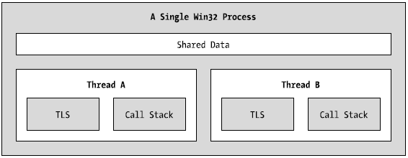
Process/AppDomain/Context/Thread
A thread is a path of execution within an executable application.
By implementing additional threads, you can build more responsive (but not necessarily faster executing) applications.
Under the .NET platform, there is not a direct one-to-one correspondence between application domains and threads.
The Win32 process/thread relationship

Slide 62
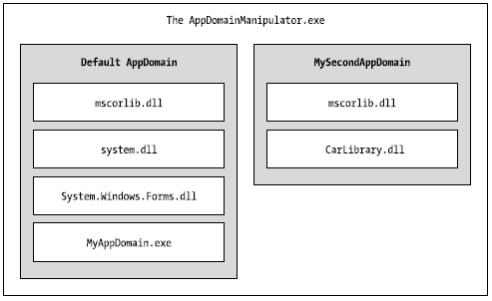
Process/AppDomain/Context/Thread
Under the .NET platform, assemblies are not hosted directly within a process. Rather, a .NET executable is hosted by a logical partition within a process termed an application domain
A single process may contain multiple application domains, each of which is hosting a .NET executable.
AppDomains is fully and completely isolated from each other within same process.

Slide 63
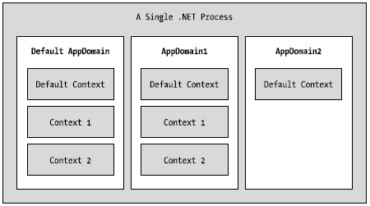
Process/AppDomain/Context/Thread
A given application domain may be further subdivided into numerous context boundaries.
Using context, the CLR is able to ensure that objects that have special runtime requirements are handled in an appropriate and consistent manner by intercepting method invocations into and out of a given context.

Slide 64

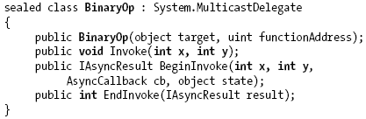
Review of the .NET Delegate

Slide 65
Steps to create a Thread
Create a type method to be the entry point for the new thread.
Create a new ParameterizedThreadStart (or legacy ThreadStart) delegate, passing the address of the method defined in step 1 to the constructor.
Create a Thread object, passing the ParameterizedThreadStart/ThreadStart delegate as a constructor argument.
Establish any initial thread characteristics (name, priority, etc.).
Call the Thread.Start() method. This starts the thread at the method referenced by the delegate created in step 2 as soon as possible.

Slide 66
Foreground Threads and Background Threads
Foreground threads have the ability to prevent the current application from terminating. TheCLR will not shut down an application (which is to say, unload the hosting AppDomain) until all foreground threads have ended.
Background threads (sometimes called daemon threads) are viewed by the CLR as expendable paths of execution that can be ignored at any point in time (even if they are currently laboring over some unit of work).
Thus, if all foreground threads have terminated, any and all background threads are automatically killed when the application domain unloads.
Example: BackgroundThread

Slide 67
The Issue of Concurrency: Race Conditions
Application
Data 1 (shared data)
Data 2
Data 3
Thread 1
Thread 2
Thread3
Thread 4
A race
occured
Need
Synchronization

Slide 68
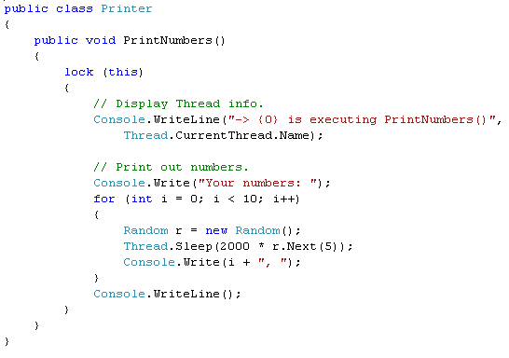
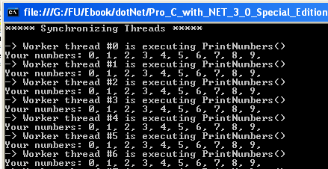
Synchronized technique: using lock()
OK
Example: Ch_14 Code\ MultiThreadedPrinting

Slide 69
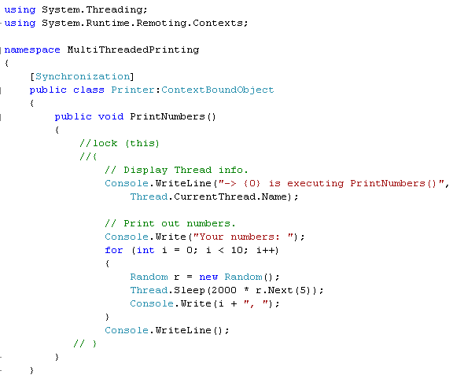
Synchronized technique: using [Synchronization] attribute
So, what to use, lock() or
[Synchronization] ???
Example: Ch_14 Code\ MultiThreadedPrinting

Slide 70
Timer Callbacks
Many applications have the need to call a specific method during regular intervals of time:
display the current time on a status bar via a given helper function.
perform noncritical background tasks such as checking for new e-mail messages.
Use the System.Threading.Timer type in conjunction with a related delegate named TimerCallback.

Slide 71
Chapter 16
System .IO Namespace

Slide 72
System.IO Namespace
I/O Class Type | Description
BinaryReader BinaryWriter | These types allow to store and retrieve primitive data types (integers, Booleans, strings, and whatnot) as a binary value.
BufferedStream | This type provides temporary storage for a stream of bytes that may be committed to storage at a later time
Directory DirectoryInfo | These types are used to manipulate directory structure. The Directory type exposes functionality primarily as static methods. The DirectoryInfo type exposes similar functionality from a valid object variable
DriveInfo | This type (new to .NET 2.0) provides detailed information regarding the drives on a given machine.
File FileInfo | These types are used to manipulate a set of files. The File type exposes functionality primarily as static methods. The FileInfo type exposes similar functionality from a valid object variable

Slide 73
System.IO Namespace
I/O Class Type | Description
FileStream | This type allows for random file access (e.g., seeking capabilities) with data represented as a stream of bytes.
FileSystemWatcher | This type allows you to monitor the modification of a given external file.
StreamWriter StreamReader | These types are used to store (and retrieve) textual information to (or from) a file. These types do not support random file access.

Slide 74
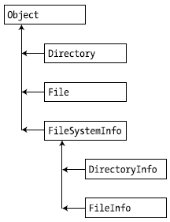
Directory(Info) and File(Info)
Directory and File expose creation, deletion,copying, and moving operations using various static members.
FileInfo and DirectoryInfo types expose similar functionality as instance-level methods (and therefore must be “new-ed”).

Slide 75
DirectoryInfo Type
Members | Description
Create() CreateSubdirectory() | Create a directory (or set of subdirectories), given a path name
Delete() | Deletes a directory and all its contents
GetDirectories() | Returns an array of strings that represent all sub directories in the current directory
GetFiles() | Retrieves an array of FileInfo types that represent a set of files in the given directory
MoveTo() | Moves a directory and its contents to a new path
Parent | Retrieves the parent directory of the specified path
Root | Gets the root portion of a path

Slide 76
FileInfo Class
Members | Description
AppendText() | Creates a StreamWriter type that appends text to a file
CopyTo() | Copies an existing file to a new file
Create() | Creates a new file and returns a FileStream type (described later) to interact with the newly created file
CreateText() | Creates a StreamWriter type that writes a new text file
Delete() | Deletes the file to which a FileInfo instance is bound
Directory | Gets an instance of the parent directory
DirectoryName | Gets the full path to the parent directory
Length | Gets the size of the current file or directory
MoveTo() | Moves a specified file to a new location, providing the option to specify a new filename

Slide 77
FileInfo Class
Members | Description
Name | Gets the name of the file
Open() | Opens a file with various read/write and sharing privileges
OpenRead() | Creates a read-only FileStream
OpenText() | Creates a StreamReader type (described later) that reads from an existing text file
OpenWrite() | Creates a write-only FileStream type

Slide 78
FileInfo Class
The FileInfo.Create() Method
If the file is already existed, this file will be overwritten by the new one
The FileInfo.Open() Method
FileInfo f2 = new FileInfo(@"C:\Test2.dat");
FileStream fs2 = f2.Open( FileMode.OpenOrCreate,
FileAccess.ReadWrite, FileShare.None);
FileMode.CreateNew: If the file already exists, a System.IO.IOException is thrown.
FileMode.Create: if the file already existed, it will be overwritten
FileMode.OpenOrCreate: Specifies that the operating system should open a file if it exists; otherwise, a new file should be created
FileMode.Open: if the file does not exist, a System.IO.IOException is thrown.
FileAccess.ReadWrite: Open to read and write
FileAccess.Read: Open to read only
FileAccess.Write : Open to write only

Slide 79
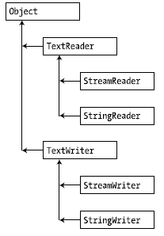
StreamWriters and StreamReaders
The StreamWriter and StreamReader classes are useful whenever you need to read or write character-based data (e.g., strings). Both of these types work by default with Unicode characters

Slide 80
Chapter 17
Object Serialization

Slide 81
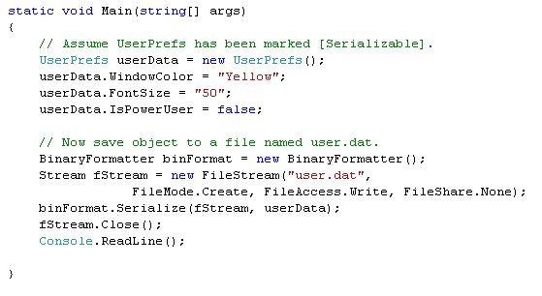
Object Serialization Concept
The term serialization describes the process of persisting (and possibly transferring) the state of an object to a stream.
The persisted data sequence contains all necessary information needed to reconstruct (or deserialize) the state of the object for use later.
Example: provide a way for end users to save their preferences to a GUI-based desktop application.

Slide 82
Object Serialization Concept
When an object is persisted to a stream, all associated data (base classes, contained objects, etc.) are automatically serialized as well.
A set of interrelated objects is represented using an object graph.
.NET serialization services also allow you to persist an object graph in a variety of formats:
Compact binary format (previous example)
A Simple Object Access Protocol (SOAP) or XML format
An object graph can be persisted into:
Local file (using System.IO.Stream-derived type)
Memory (using MemoryStream type)

Slide 83
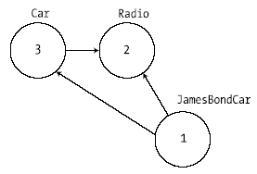
Object Serialization Concept
The Role of Object Graphs
The set of related objects is collectively referred to as an object graph.
Object graphs provide a simple way to document how a set of objects refer to each other
Each object in an object graph is assigned a unique numerical value.
Once all objects have been assigned a numerical value, the object graph can record each object’s set of dependencies.

Slide 84
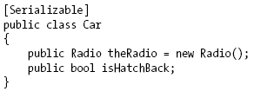


Configuring Objects for Serialization
Decorate each related class with the [Serializable] attribute to make an object available to .NET serialization services.
Mark fields with [NonSerialized] if they should not (or perhaps cannot) participate in the serialization scheme.
The [Serializable] attribute cannot be inherited.

Slide 85
Configuring Objects for Serialization
Public Fields, Private Fields, and Public Properties
BinaryFormatter serialize all serializable fields of a type, regardless of whether they are public fields, private fields, or private fields exposed through type properties.
XmlSerializer or SoapFormatter only serialize public field data or private data exposed through public properties.

Slide 86
Choosing a Serialization Formatter
BinaryFormatter type, it will not only persist the field data of the objects in the object graph, but also each type’s fully qualified name and the full name of the defining assembly
ideal choice for transferring objects by value (e.g., as a full copy) across machines
The SoapFormatter and XmlSerializer only persist public field data/public properties
ideal choices for transferring among OS (Windows XP, Mac OS X, and *nix distributions) and application framework (.NET, J2EE, COM, etc.)

Slide 87
Chapter 22
Database Access with ADO.NET

Slide 88
ADO.NET over ADO
In-memory Representations of Data
In ADO, the in-memory representation of data is the recordset. In ADO.NET, it is the dataset.
A recordset looks like a single table. If a recordset is to contain data from multiple database tables, it must use a JOIN query, which assembles the data from the various database tables into a single result table.
In contrast, a dataset is a collection of one or more tables. In this way, a dataset can mimic the structure of the underlying database.

Slide 89
ADO.NET vs ADO
Minimized Open Connections
In ADO.NET you open connections only long enough to perform a database operation, such as a Select or Update. You can read rows into a dataset and then work with them without staying connected to the data source.
In ADO the recordset can provide disconnected access, but ADO is designed primarily for connected access.

Slide 90
ADO.NET vs ADO
Sharing Data Between Applications
To transmit an ADO disconnected recordset from one component to another, you use COM marshalling
To transmit data in ADO.NET, you use a dataset, which can transmit an XML stream: richer data types, better performance, penetrating firewalls
ADO.NET is a managed library of code

Slide 91
ADO.NET models
Connected layer:
explicitly connect to and disconnect from the underlying data store.
typically interact with the data store using connection, command, and data reader objects.
Disconnected layer:
Obtain a client-side copy of the external data (the connection is automatically opened and closed).
Interact with SqlDataAdapter, DataSet, DataTable objects

Slide 92
ADO.NET Data Providers
ADO.NET supports multiple data providers, each of which is optimized to interact with a specific DBMS.
Benefits:
A Specific data provider can be programmed to access any unique features of the DBMS.
A specific data provider is able to directly connect to the underlying engine of the DBMS without an intermediate mapping layer standing between the tiers.

Slide 93
ADO.NET Data Providers
Microsoft-Supplied Data Providers
OLE DB is used for interacting with a DBMS that does not define a specific.
Microsoft SQL Server offers direct access to MS SQL Server data stores.
Data Provider | Namespace | Assembly
OLE DB | System.Data.OleDb | System.Data.dll
Microsoft SQL Server | System.Data.SqlClient | System.Data.dll
Microsoft SQL Server Mobile | System.Data.SqlServerCe | System.Data.SqlServerCe.dll
ODBC | System.Data.Odbc | System.Data.dll
Oracle | System.Data.OracleClient | System.Data.OracleClient.dll

Slide 94
ADO.NET: Connected Layer
The connected layer of ADO.NET allows to interact with a database using the connection, command, and data reader objects
Steps to connect to a database and read the records using a data reader object:
Allocate, configure, and open your connection object (sqlConnection).
Allocate and configure a command object (SqlCommand), specifying the connection object as a constructor argument or via the Connection property.
Call ExecuteReader() on the configured command object.
Process each record using the Read() method of the data reader (SqlDataReader).

Slide 95
ADO.NET: Connected Layer
Connection Objects (SqlConnection)
Establish a session with the data source.
ConnectionString property: identify the name of the machine you wish to connect to, required security settings, the name of the database on that machine, and other data provider–specific information.
Example: "uid=sa;pwd=;Initial Catalog=Cars; Data Source=(local)";

Slide 96
ADO.NET: Connected Layer
Command Objects (SqlCommand)
The SqlCommand,which derives from DbCommand, is an OO representation of a SQL query, table name, or stored procedure.
The type of command is specified using the CommandType property, which includes:
StoredProcedure,
TableDirect,
Text // Default value.
Member | Description
CommandTimeout | Gets or sets the time to wait while executing the command before terminating the attempt and generating an error. The default is 30 seconds.
ExecuteNonQuery() | Issues the command text to the data store (Update, insert, delete).
ExecuteReader() | Returns the data provider’s DbDataReader object, which provides forward-only, read-only access to the underlying data.
ExecuteXmlReader() | Returns result sets as XML

Slide 97
ADO.NET: Connected Layer
Data Readers
The DbDataReader type (which implements IDataReader) is the simplest and fastest way to obtain information from a data store.
Data readers represent a read-only, forward-only stream of data returned one record at a time.
Data readers are useful only when submitting SQL selection statements to the underlying data store.
Data readers are useful when you need to iterate over large amounts of data very quickly and have no need to maintain an in-memory representation.
Data reader objects (unlike data adapter objects) maintain an open connection to their data source until you explicitly close the session.
The Read()method to determine when the end of your records have been reached (via a false return value)

Slide 98
Working with Parameterized Command Objects
Building a SQL statement using string concatenation can be risky from a security point of view (ex: SQL injection attacks).
Parameterized queries execute much faster than a literal SQL string, in that they are parsed exactly once
To associate a parameter within a SQL query to a member in the command object’s parameters collection, prefix the SQL text parameter with an at (@) symbol
Property | Description
DbType | Gets or sets the native data type from the data source
Direction | Gets or sets whether the parameter is input-only, output-only, bidirectional, or a return value parameter
ParameterName | Gets or sets the name of the DbParameter
Value | Gets or sets the value of the parameter

Slide 99



Parameterized Demo (Ch_22 Code\CarsInventoryUpdater)
Insert data using parameterized

Slide 100
ADO.NET: Disconnected Layer
Data adapter (which extends the abstract DbDataAdapter) is used to fetch and update data.
Data adapter objects make use of DataSet objects to move data between the caller and data source.
The DataSet type is a container for any number of DataTable objects, each of which contains a collection of DataRow and DataColumn objects.

Slide 101

ADO.NET: Disconnected Layer
Data adapter objects move DataSets to and from the client tier.
The data adapter handles the database connection automatically and keeps the connection open for the shortest possible amount of time.

Slide 102
ADO.NET: Disconnected Layer
Once the caller receives the DataSet object, the connection is completely disconnected from the DBMS and left with a local copy of the remote data.
The caller is free to insert, delete, or update rows from a given DataTable, but the physical database is not updated until the caller explicitly passes the DataSet to the data adapter for updating.

Slide 103

ADO.NET: Disconnected Layer
DataSet
A DataSet is an in-memory representation of external data.
A DataSet is a class type that maintains three internal strongly typed collections

Slide 104
ADO.NET: Disconnected Layer
DataSet Elements
DataTableCollection can be accessed via Table property that contains the individual DataTables.
DataRelationCollection can be accessed through the Relations property.
A relation can be created between two tables to model a foreign key constraint using the DataRelation type.
PropertyCollection: can be accesed via ExtendedProperties that allows to add any extra information to the DataSet as name/value pairs.

Slide 105
Chapter 23:
ASP.NET 2.0 Web Pages and Web Controls

Slide 106

The Role of HTTP
HTTP (Hyper Text Transfer Protocol) is a text-based protocol that is built upon a standard request/response paradigm.
The HTTP request and response cycle
HTTP is an essentially stateless protocol

Slide 107
Web Applications and Web Servers
A web application can be understood as a collection of files (*.htm, *.asp, *.aspx, image files, etc.) and related components (such as a .NET code library) stored within a particular set of directories on a given web server.
A web server is a software product in charge of hosting your web applications, and it typically provides a number of related services such as integrated security, File Transfer Protocol (FTP) support, mail exchange services, and so forth.

Slide 108
The Role of HTML
HTML is a language for describing web pages.
HTML stands for Hyper Text Markup Language
HTML is not a programming language, it is a markup language
A markup language is a set of markup tags
HTML uses markup tags to describe web pages
HTML Documents = Web Pages
HTML documents describe web pages
HTML documents contain HTML tags and plain text
HTML documents are also called web pages

Slide 109
The Role of HTML
HTML markup tags are usually called HTML tags
HTML tags are keywords surrounded by angle brackets, that begin “<” and finish with “>”, like <html>
HTML tags normally come in pairs like <b> and </b>
The first tag in a pair is the start tag, the second tag is the end tag
Start and end tags are also called opening tags and closing tags.
Web Browser
The purpose of a web browser (like Internet Explorer, or Firefox, etc) is to read HTML documents and display them as web pages.
The browser does not display the HTML tags, but uses the tags to interpret the content of the page

Slide 110
HTTP protocol/HTML page/Web Server
1. Convert http://microsoft.com/ to 192.168.54.3:80
Connect
2. Send a request to Web Server (index.html)
4. The result is responsed to Browser
http://microsoft.com/index.html
192.168.54.3:80
5. Web Browser views the result which contains a markup language
3. Web Server processes a request (connecting DB, calculating, call service …)
Request – Response pairs
Stateless
Port 80 is default

Slide 111
GET / POST
GET:
Is the method commonly used to request a resource/ get information (access static resource such as HTML doc and images or retrieve dynamic information such as query parameters) from server
The length of query string, that is introduced by the question mark “?”, is restricted 240 to 255
Is trigger by
Typing into the address line of the browser and pressing GO
Clicking on a link in a web page
Pressing the submit button in an HTML <form> whose method is set to GET
POST: sends data of unlimited length to the web server
Is the method commonly used for passing user input/ sending information to the server (access dynamic resources and enable secure data in HTTP request because the request parameters are passed in the body of request)
No limit of length and cannot be booked mark

Slide 112
The Role of Client-Side Scripting
There are two major reasons to use client-side scripting:
To validate user input before posting back to the web server.
To interact with the Document Object Model (DOM) of the target browser
Client scripts examples: VBScript, JavaScript.
VBScript:
Subset of the Visual Basic 6.0
Only supported by IE.
JavaScript:
In no way, shape, or form a subset of the Java language.
Have a somewhat similar syntax to Java.
Not a full-fledged OOP language,
Supported by all browsers.
Example: Ch_23 code\CarsWebSite\default.htm

Slide 113
Major Benefits of ASP.NET 1.x
ASP.NET 1.x provides a model termed code-behind, which allows you to separate presentation logic from business logic.
ASP.NET 1.x pages are compiled .NET assemblies, not interpreted scripting languages, which translates into much faster execution.
Web controls allow programmers to build the GUI of a web application in a manner similar to building aWindows Forms application.
ASP.NET web controls automatically maintain their state during postbacks using a hidden form field named __VIEWSTATE.
ASP.NET web applications are completely object-oriented and make use of the CTS.
ASP.NET web applications can be easily configured using standard IIS settings or using a web application configuration file (Web.config).

Slide 114
Major Enhancements of ASP.NET 2.0
ASP.NET 2.0 no longer requires websites to be hosted under IIS during the testing and development of your site.
ASP.NET 2.0 ships with a large number of new web controls (security controls, new data controls, new UI controls, etc.) that complement the existing ASP.NET 1.x control set.
ASP.NET 2.0 supports the use of master pages, which allow you to attach a common UI frame to a set of related pages.
ASP.NET 2.0 supports themes, which offer a declarative manner to change the look and feel of the entire web application.
ASP.NET 2.0 supports web parts, which can be used to allow end users to customize the look and feel of a web page.
ASP.NET 2.0 supports a web-based configuration and management utility that maintains your Web.config files.

Slide 115
The ASP.NET Web Page Code Model
ASP.NET web pages can be constructed using one of two approaches:
Single-file page model:
A single *.aspx file that contains a blend of server-side code and HTML (much like classic ASP).
Server-side code is placed within a <script> scope
Languages to script code: C#, VB.NET,…
Advantages:
Easier to deploy or to send to another developer.
Because there is no dependency between files, a single-file page is easier to rename.
Managing files in a source code control system is slightly easier, as all the action is taking place in a single file.

Slide 116
The ASP.NET Web Page Code Model
Code-behind:
Separates your programming code from your HTML presentation logic using two distinct files.
Works quite well when your pages contain significant amounts of code or when multiple developers are working on the same website.
Advandtages:
It is possible to have designers working on the markup while programmers author the C# code.
Code is not exposed to page designers or others who are working only with the page markup (as you might guess, HTML folks are not always interested in viewing reams of C# code).
Code files can be used across multiple *.aspx files.

Slide 117
Master Pages
Master page provides a consistent look and feel across multiple pages (a common menu navigation system, common header and footer content, company logo, etc.).
A master page is little more than an ASP.NET page that takes a *.master file extension.
Master pages are not viewable from a client-side browser (in fact, the ASP.NET runtime will not server this flavor of web content).
Master pages define a common UI frame shared by all pages (or a subset of pages) in your site.

Slide 118
Chapter 24:
ASP.NET 2.0 Web Applications

Slide 119
The Issue of State
HTTP has no clue how to automatically remember data once the HTTP response has been sent, it stands to reason that the Page object is destroyed instantly. Therefore, when the client posts back to the *.aspx file, a new Page object is constructed that will reset any page-level member variables.
It is the same to Java servlets, CGI applications, classic ASP, and PHP.

Slide 120
ASP.NET State Management Techniques
ASP.NET provides several mechanisms to maintain stateful information in your web applications:
Make use of ASP.NET view state.
Make use of ASP.NET control state.
Define application-level variables.
Make use of the cache object.
Define session-level variables.
Interact with cookie data.

Slide 121

Understanding the Role of ASP.NET View State
ASP.NET runtime will automatically embed a hidden form field (named __VIEWSTATE), which will flow between the browser and a specific page.
The data assigned to this field is a Base64-encoded string that contains a set of name/value pairs that represent the values of each GUI widget on the page at hand.
Init event handler is the entity in charge of reading the incoming values found within the __VIEWSTATE field to populate the appropriate member variables in the derived class.

Slide 122
The Role of the Global.asax File
Each ASP.NET web application has one Global.asax file that contains some functions that can be invoke during that application life cycle
Event Handler | Description
Application_Start() | This event handler is called the very first time the web application is launched
Application_End() | This event handler is called when the application is shutting down
Session_Start() | This event handler is fired when a new user logs on to your application. Here you may establish any user-specific data points.
Session_End() | This event handler is fired when a user’s session has terminated (typically through a predefined timeout).
Application_Error() | This is a global error handler that will be called when an unhandled exception is thrown by the web application.

Slide 123

Application/Session Distinction
Application state is maintained by an instance of the HttpApplicationState type.
This class enables to share global information across all users (and all pages) who are logged on to your ASP.NET application.
Session state is maintained by HttpSessionState class type
used to remember information for a specific user
When a new user logs on to an ASP.NET web application, the runtime will automatically assign that user a new session ID.

Slide 124
Understanding Cookies
Cookie is a text file (or set of files) on the user’s machine.
When a user logs on to a given site, the browser checks to see if the user’s machine has a cookie file for the URL in question and, if so, appends this data to the HTTP request.
The receiving server-side web page could then read the cookie data to create a GUI that may be based on the current user preferences.
Cookies are stored by default under C:\Documents and Settings\<loggedOnUser>\Cookies.
Cookies are a horrible choice when you wish to maintain sensitive information about the current user (such as a credit card number, password, or whatnot).

Slide 125
Understanding Cookies
Creating Cookies
ASP.NET cookies can be configured to be either persistent or temporary:
A persistent cookie is typically regarded as the classic definition of cookie data, in that the set of name/value pairs is physically saved to the user’s hard drive.
Temporary cookies (also termed session cookies) contain the same data as a persistent cookie, but the name/value pairs are never saved to the user’s machine; rather, they exist only within the HTTP header. Once the user logs off your site, all data contained within the session cookie is destroyed.
Note: Most browsers support cookies of up to 4,096 bytes => cookies are
best used to store small amounts of data, such as a user ID that can be
used to identify the user and pull details from a database.

Slide 126

Configuring ASP.NET Web Application Using Web.config
In ASP .NET, the web-centric configuration files are always named Web.config, with default structure:

Slide 127
Configuring ASP.NET Web Application
Element | Description
<appSettings> | establish custom name/value pairs that can be programmatically read in memory for use by your pages
<authentication> | used to define the authentication mode for this web application.
<authorization> | used to define which users can access which resources on the web server.
<compilation> | used to enable (or disable) debugging
<connectionStrings> | used to hold external connection strings
<customErrors> | used to tell the runtime exactly how to display errors
<globalization> | used to configure the globalization settings
<sessionState> | used to control how and where session state data will be stored by the .NET runtime.
<trace> | This element is used to enable (or disable) tracing support for this web application.

Slide 128
Chapter 25:
XML Web Services

Slide 129
XML Web Services Introduction
What is Web service?
Web services are typically application programming interfaces (API) or web APIs that are accessed via Hypertext Transfer Protocol(HTTP) and executed on a remote system
Benefits of XML Web Services
XML web services allow you to invoke methods and properties of a remote object using standard HTTP requests.
XML web services provide a way for unrelated platforms, operating systems, and programming languages to exchange information in harmony.

Slide 130
XML Web Services Introduction
XML Web Service Clients
XML web service client is not limited to a web page
The proxy’s implementation code forwards requests to the XML web service using standard HTTP.
The proxy also maps the incoming stream of XML back into .NET-specific data types (or whatever type system is required by the consumer application).

Slide 131

XML Web Services Introduction

Slide 132





UDDI (Web Service Discovery /Broker)
SOAP
Publish
Find
SOAP
Internet
IIS
Bind
Web Service Provider
SOAP
Web Service Consumer

Slide 133
XML Web Services Introduction
XML Web Service Components
An XML web service involves the following core technologies:
A discovery service: helps clients resolve the location of the XML web service.
A description service: helps clients know what the XML web service can do.
A transport protocol: pass the information between the client and the XML web service.

Slide 134
XML Web Services Introduction
XML Web Service Discovery
In order to allow client to look up a web service, it must be registered with a Universal Description, Discovery, and Integration (UDDI) server.
Clients may submit request to a UDDI catalog to find a list of all web services that match some search criteria.
In addition to UDDI catalog, Client can use Discovery of Web Services (DISCO) to locate Web services.

Slide 135
XML Web Services Introduction
XML Web Service Description
The client must fully understand the exposed functionality before invoking methods.
A XML web service is described using Web Service Description Language (WSDL).
WSDL will be automatically generated by Microsoft IIS when the incoming request has a ?wsdl suffix.
Use wsdl.exe to generate proxy type for an XML web service based on a WSDL definition.

Slide 136
XML Web Services Introduction
Transport Protocol.
HTTP GET, HTTP POST, or SOAP can be used to move information between consumers and web services.
SOAP messages can contain XML descriptions of complex types (including your custom types as well as types within the .NET base class libraries).
HTTP GET or HTTP POST protocols is restricted to a more limited set of core data XML schema types.

Slide 137
The Role of the WebService Base Class
if you wish to build a stateful web service using Application and Session variables, you are required to derive from WebService.
if you are building an XML web service that does not require the ability to “remember” information about the external users, extending WebService is not required.

Slide 138


The [WebService] Attribute
The Name Property
Used to establish the name of the XML web service exposed to the outside world.
By default, the external name of a web service is identical to the name of the class type itself (Service by default).

Slide 139

[WebServiceBinding] Attribute
Used to specify if the XML web service conforms to “Web services interoperability (WSI) basic profile 1.1”.
By default, XML web services generated using Visual Studio 2005 are assumed to conform to the WSI basic profile 1.1.
For example: overloading methods are not allowed in WSI basic profile 1.1
(http://www.ws-i.org/Profiles/BasicProfile-1.1.html)

Slide 140


Slide 141

Ignoring BP 1.1 Conformance Verification

Slide 142
The [WebMethod] Attribute
The [WebMethod] attribute must be applied to each method you wish to expose from an XML web service

Slide 143
Thank you

